Slide 1


UE21CS320A – Capstone Project Approval
Project Title : Traffix: Dynamic Scheduling of Traffic Signals Using Machine Learning
Project ID : 34
Project Guide : Dr. Mannar Mannan
Project Team : Kushaagra Shrivastava PES2UG21CS917
Harshita Khajuria PES2UG21CS194
Rishab A Kumar PES2UG21CS429
Rahul G Pai PES2UG21CS414

Slide 2

Outline
Problem Statement
Scope and Feasibility study
Applications/Use cases
Expected Deliverables
Capstone (Phase-I & Phase-II) Project Timeline
Any other information

Slide 3
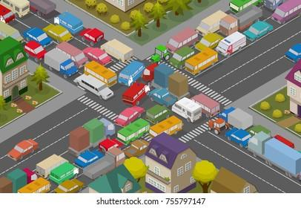
Problem Statement
Currently, on our roads, traffic signals operate in 1 out of 2 ways. Either they are pre assigned a routine where a given signal, or pair of them go green at once, whilst the rest stay red. Or they are operated manually. Additionally, methods to calculate congestion at a signal are all classification based and use simple neural networks
Repercussions:
Idle greenlit lanes- green light for a lane with no vehicles.
Excessive congestion at crowded lanes.
No pre-programmed pre-emption for emergency services.
Manual control necessary during peak hours in certain junction.

Slide 4
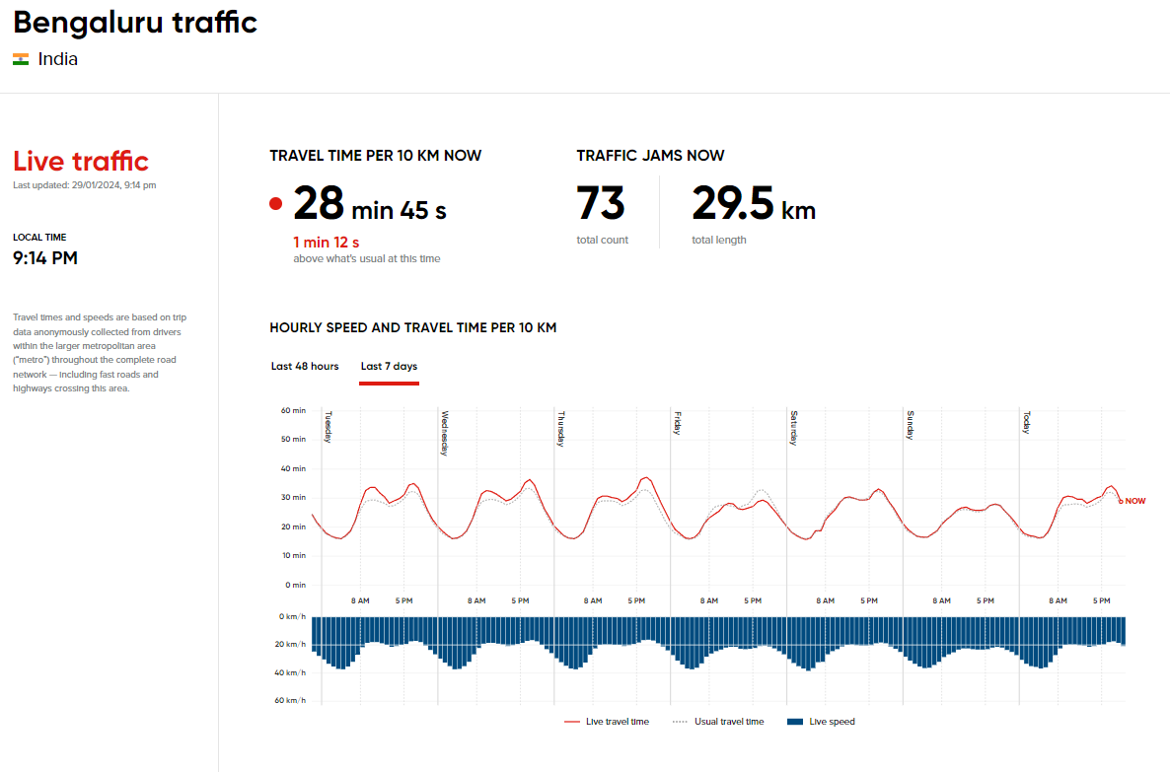
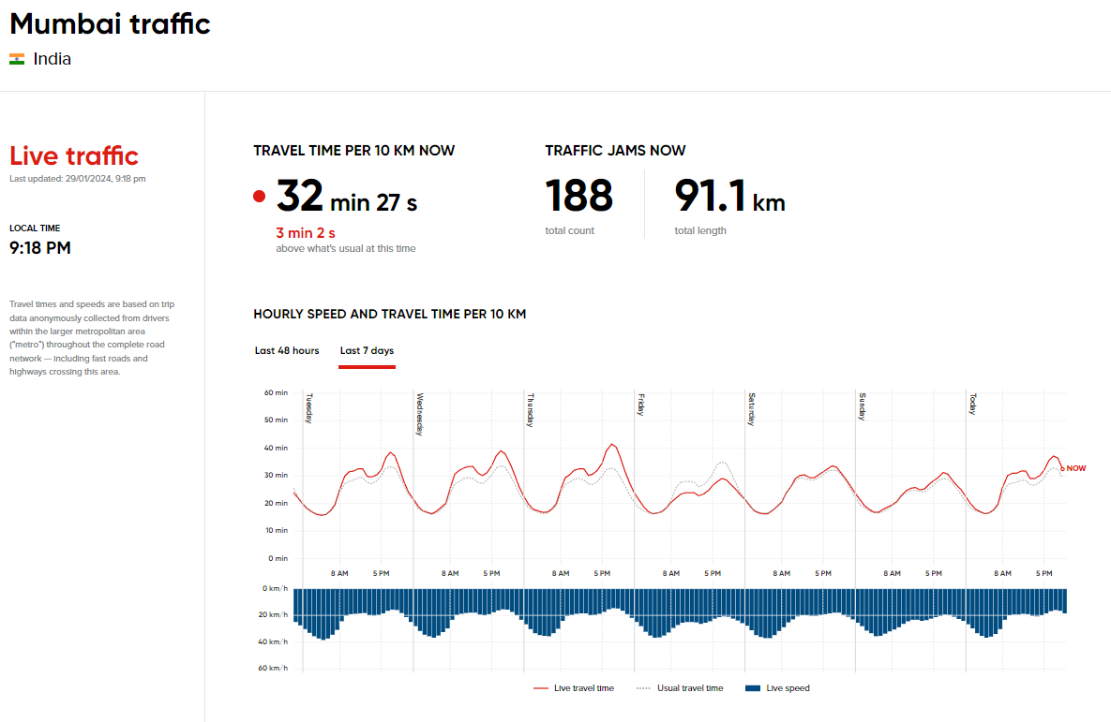
Some Statistics
Source

Slide 5
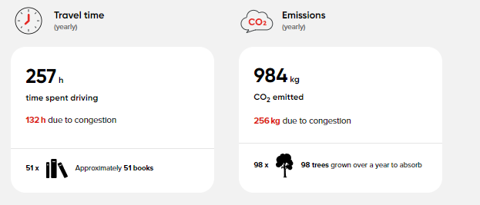
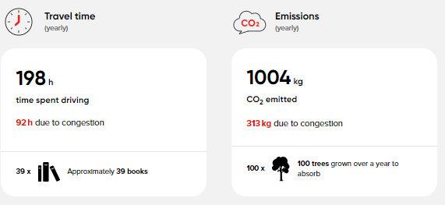
Some Statistics
Bengaluru
Mumbai
Reducing congestion and improving throughput at signals will have a substantial positive impact on the numbers given above.
Source

Slide 6
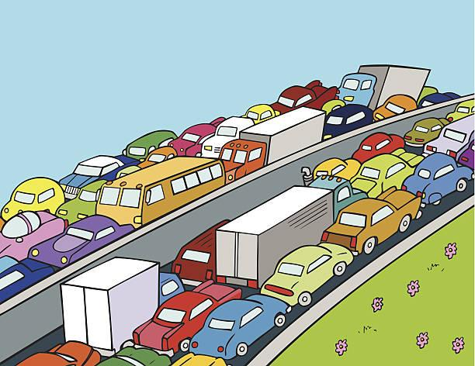
Scope and Feasibility study
Scope:
This project proposes an machine learning (ML) system for Dynamic schedule of traffic signals using image processing aimed at alleviating urban congestion.
Our system addresses the limitations of traditional fixed-time methods by enabling real-time, lane-specific adjustments based on actual traffic conditions captured in camera images.
Shortcomings & Challenges:
Real time processing of traffic signal data would require lightweight and quick models. The project would require 2 different models running simultaneously –
Image based model to calculate congestion using vehicle and traffic data
A model that learns how traffic flows at a signal to maximise throughput

Slide 7
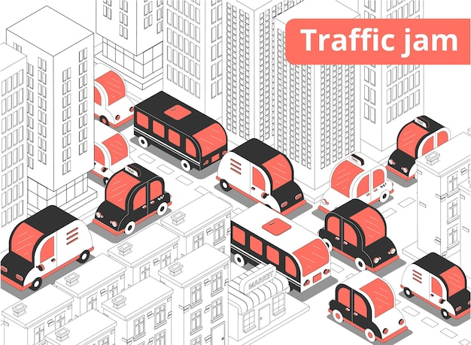
Scope and Feasibility study
Legal Feasibility: LOW
No aspect of the proposed project conflicts with legal requirements.
Data Feasibility: HIGH
Vehicle and traffic congestion datasets are easily and freely available.
Computation Feasibility: MODERATE
Would require either medium to high grade GPUs or Cloud platforms for model training on Images.
Schedule Feasibility: MODERATE
14-18 weeks

Slide 8
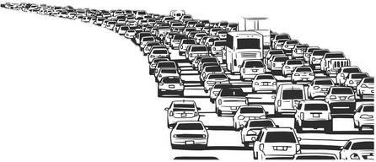
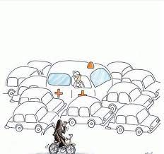
Applications/Use cases
This adaptive strategy aims to:
Minimize overall waiting times for vehicles by prioritizing queues and preventing congestion.
Halting movement in idle greenlit lanes by dynamically adjusting to current congestion and turn probability, increasing overall throughput at a given junction.
Improve responsiveness to real-time traffic fluctuations, adapting to unpredictable spikes and emergencies.
Adapt right/left turn signal times based on previously collected data of vehicle manoeuvres
Detection of vehicle traffic violations at signals
Allow for pre-emption of signals for emergency services

Slide 9
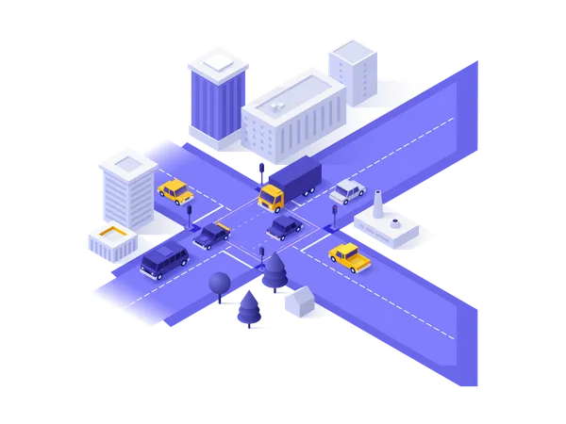
Expected Deliverables
Capstone-I deliverables:
Project scope, feasibility, use cases.
Literature surveys and previous work.
Data to be used.
Capstone-II deliverables:
Image database creation of vehicles at traffic signals.
Traffic congestion detection model along with its training script.
Smart traffic signal control system algorithm and model.
UI design.
Final project after complete validation.

Slide 10
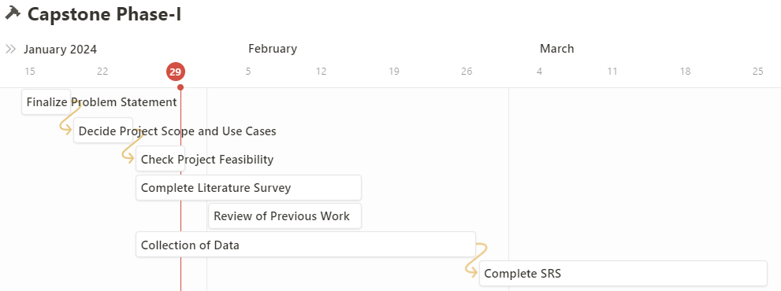
Capstone (Phase-I & Phase-II) Project Timeline

Slide 11
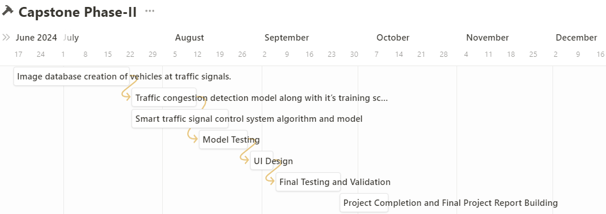
Capstone (Phase-I & Phase-II) Project Timeline

Slide 12
Datasets
https://www.researchgate.net/figure/Successful-detection-of-an-ambulance-in-traffic_fig2_344596914
https://www.istockphoto.com/search/search-by-asset?assetid=155287967&assettype=image
https://www.kaggle.com/datasets/fedesoriano/traffic-prediction-dataset
https://lewatmana.com/
https://www.kaggle.com/datasets/ashfakyeafi/road-vehicle-images-dataset
https://drive.google.com/drive/folders/1QCQaw4sr9j228ZWvBvGMGjaaS3NKv5Wv

Slide 13
References
Image Processing and IoT Based Dynamic Traffic Management System
Smart Traffic Detection and Control using Machine Learning Techniques
Traffic Analysis using Image Processing to Alert
Smart traffic control with ambulance detection
Real-time Dynamic Traffic Light Control System with Emergency Vehicle Priority
Machine Learning Approach on Traffic Congestion Monitoring System in Internet of Vehicles
Image Processing and IoT Based Dynamic Traffic Management System
Traffic Congestion Detection: Learning from CCTV Monitoring Images using Convolutional Neural Network

Slide 14
Thank You

